Slide 1
Client Experience(CX)
Case Study Presentation
Parth Pendal

Slide 2
Agenda
Introduction and Experiment Objective
Research design
Target audience
Ensuring bias is not introduced
Experiment Duration
Findings
Leaning/idea for future experiments

Slide 3

Introduction
For a 5-step process, existing system was redesigned with modern UI, navigation and in-line help features.
Start ➔ Step 1 ➔Step 2 ➔ Step 3 ➔ Confirm
An experiment was designed to perform A/B testing which will compare existing UI with the modern UI
Experiment period : 3/15/2017 to 04/30/2017.

Slide 4

Experiment Objective
Client Analysis
Analysis of clients participated in the experiment and duration
Define and Measuring
Success
Conversion Ratio
Learning/Idea for future experiments
Experiment Duration
Determine time period for the experiment
Learning and Idea

Slide 5
Research Design
Identify Targeted audience
Capturing primary information of clients identified for the experiment.
Split audience
Audience was split into two different group randomly.
Both groups should have significant number of sample so that we have enough data for conclusion.
Capture logs
Analysis and conclusion
Understand how client is responding to a new UI compared to the existing one.
Ensure logs are analyzed only for the date range during experiment was performed.
One group was redirected to the existing UI and other group was redirected to the modern UI.
Ensure log capture process is similar for both the groups.
Capture learnings/idea for future.
Targeted audience should represent actual population.
Experiment duration is kept same for both the groups.

Slide 6
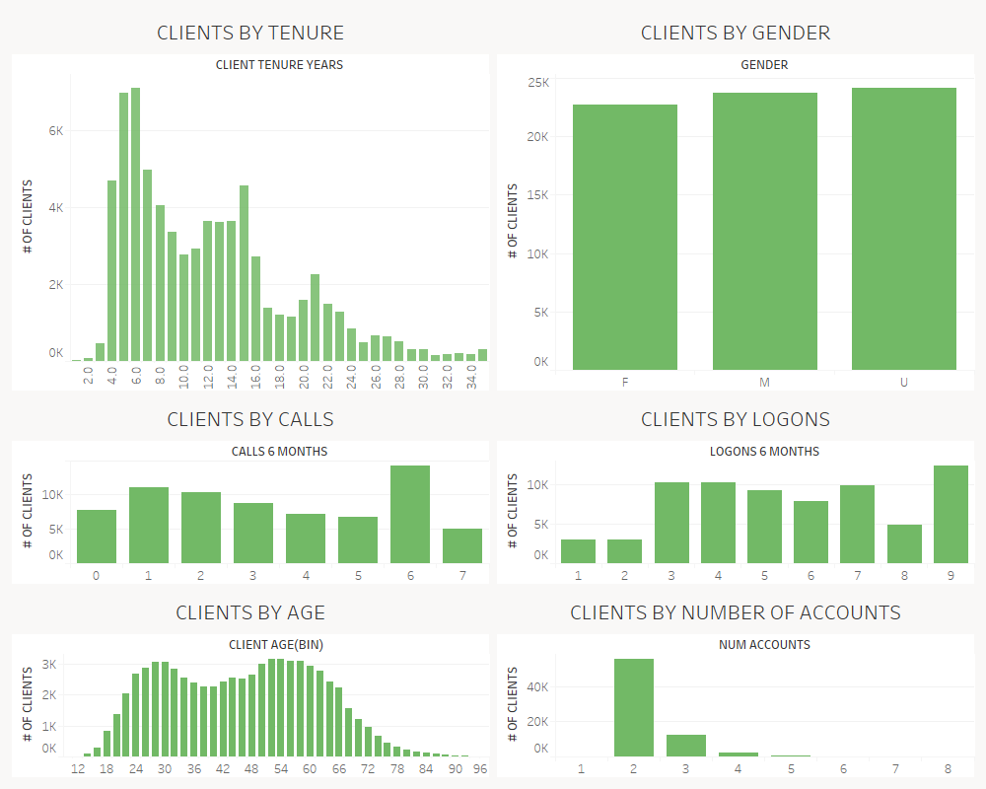
Target Audience
Set of audience for the experiment were across all Gender, Tenure, Calls, logons, Age , number of accounts.
Observations:
Clients with number of accounts 1 were not part of the experiment.
Clients with unknown gender was higher.
Not sufficient information for 14 clients (Null data)
Notes:
Client with account number 1 is not involved in the experiment

Slide 7
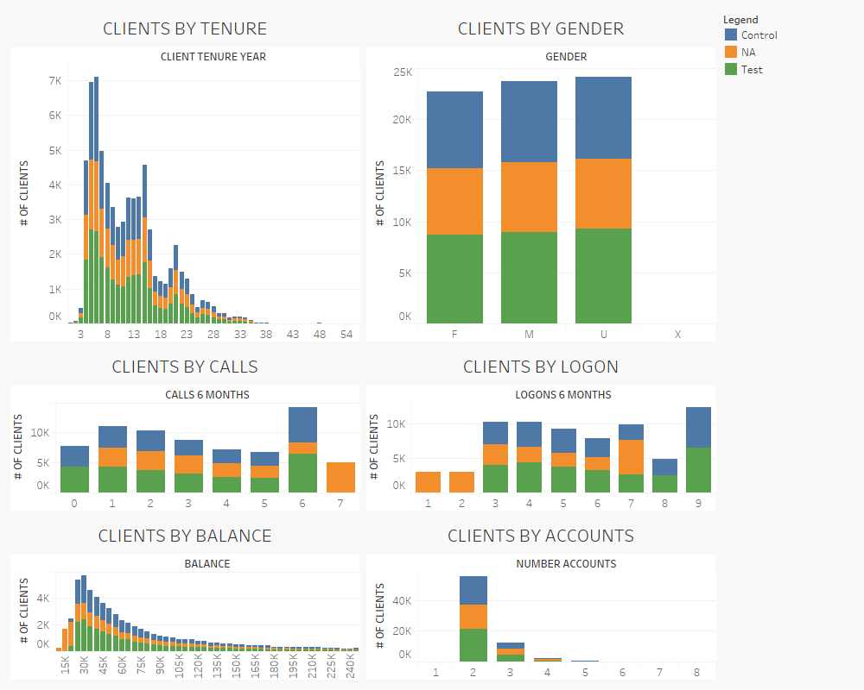
Ensuring bias is not introduced
Samples for Control and test group were representing all the type of clients.
Observations:
Clients 1 or 2 logons in last 6 months were not part of either control and test group.
Clients with 7 number of calls in last 6 months were not part of any groups.
Clients with balance less that 23K were neither part of Control group nor Test group.
Notes:
Client count by call 7 in involved in the experiment
Client count by logon <2 not involved int the experiment
Client with account number 1 is not involved in the experiment

Slide 8
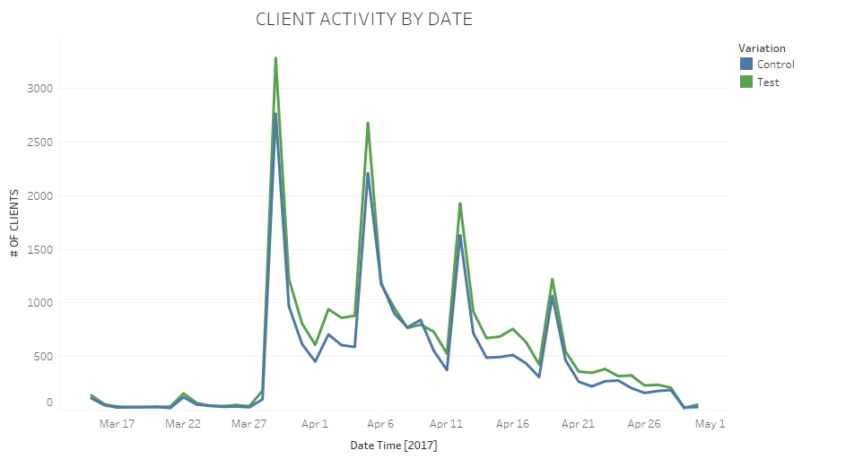
Experiment Duration
Higher activity Reason: New Quarter
Experiment duration was selected as 03/15/2017 to 04/30/2017 seems to be sufficient.
This includes quarter end time which helped analyzing system performance in the high load time.
However, might need to understand how both system would behave during start of new year when load would be significantly high.
Notes:
Quarter end was covered. Year end should be converted to understand peak volume.

Slide 9
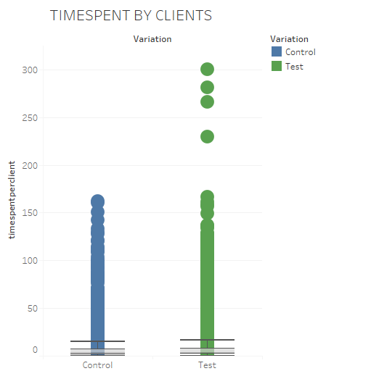
Findings
Mean time spent by each client is higher for test group compared to control group. Median, 25 percentile, 75 percentile values are bit higher which gives indication of higher client involvement.
Do not see significant difference in the mean time spent per session and mean number of session per client for client who reached till confirmation page.
Time Spent Clients | Time Spent Cilents
 | Control | Test
Mean | 6.1 | 7.09
Lower Hinge | 1.7 | 2
Median | 3.8 | 3.9
Upper Hinge | 7.2 | 7.9
Users who reached confirm stage
 | Control | Test
Mean number of sessions per client | 1.31 | 1.34
Mean Time Spent in each session (in Minutes) | 5.90 | 5.87
Mean Time Spent by each client (in Minutes) | 7.70 | 7.95
Notes:
Quarter end was covered. Year end should be converted to understand peak volume.

Slide 10
Findings
Participants
Start Activity
Step 1
Step 2
Step 3
Confirm
Control Group clients:~18K
Test Group clients: ~21.7K
Control Group clients: ~14K
Test Group clients: ~18.1K
Clients in Control Group: ~11.3K
Clients in Test Group: ~15K
Control Group clients: ~24K
Test Group clients: ~27K
Not in any groups: ~20K
Control Group clients: ~15K
Test Group clients: ~19.7K
Clients in Control Group: ~13K
Clients in Test Group: ~17K
16% drop in the clients was observed for control group clients in the step 1 itself. For test group drop at step 1 was less.
Significant improvement was observed for Conversion rate (% of clients who started the process has reach till completion) in modern UI.
16% drop

Slide 11
Idea for future experiments
Performing such testing during new financial year when load is high would give higher confidence in our observation.
Customers across different geographical locations should be analyzed.
Pushing survey (through email) for the clients who did not complete the process can help in understanding reason for the drop.
Once user completes the process, they can be redirected to the survey page for feedback.
Client calls during the experiment.
Testing Peak load and different geographies
Direct survey
In-line feature was introduced in modern UI
This feature should reduce number of calls to helpdesk.
Capturing and analyzing number of the calls clients have made during the experiment would help in understanding it’s success,

Slide 12

Thank you

